Slide 1


A research project on privacy of distributed algorithms
Project number:2901
Tom Kaninin
Jonathan Yaffe
Supervisor: Ilai Bistritz
Project carried out at: Tel Aviv University

Slide 2
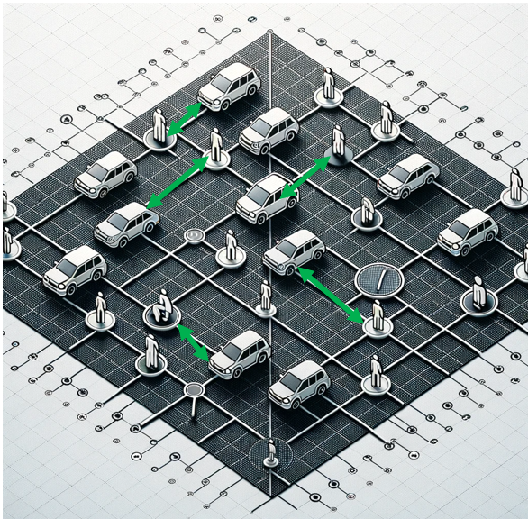
Project Topic – Private ride sharing
Notes:
About ride sharing - Ride-sharing is a service that allows individuals to book shared rides via mobile apps, transforming urban mobility by providing cost-effective and convenient transportation alternatives. This model not only reduces traffic congestion and emissions but also offers increased accessibility, particularly benefiting those who may not own a vehicle or are unable to drive.

Slide 3
Project key points
The Matching Problem in Ride-Sharing
Uncertainty and Privacy Concerns
Simulation Environment
Privacy and Performance Trade-offs
Performance Evaluation

Slide 4
Project Requirements and Deliverables
Problem Formulation
Algorithm Design
Privacy and performance measures
Simulation Software
Evaluation Of Different Algorithms

Slide 5
Updated and elaborated block diagram
Each passenger adds uniform ball noise to its location and sends to server
The server runs a centralized Algorithm and finds a matching
Centralized Approach
Collect Passenger location
Distributed Approach
Calculate distance from each driver
Add uniform noise for each distance independently and send to each driver the corresponding distance
Each driver runs a distributed Algorithm and finds a matching

Slide 6
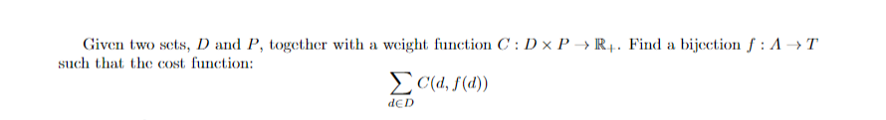
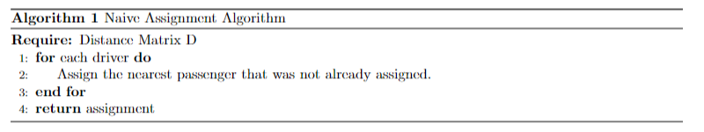
Project products achieved so far-
Problem Formulation – The Assignment Problem
Centralized and distributed algorithms- naïve algorithm, Hungarian algorithm

Slide 7
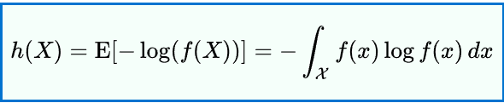
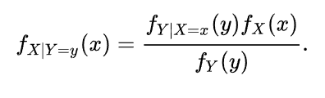
Privacy measure
Privacy measure – Differential Entropy
Location ball noise
Distance Noise
Notes:
In the left case the center of the ball is the reported location. In the right case the center of the ring is the driver’s location. We assume that the distribution of the noised locations is the same as the distribution of locations so we can use bayes rule to find the PDF of the passenger location.

Slide 8
Simulation results

Slide 9
Milestone | Planned delivery date | Actual delivery date | Remarks
Mathematical Problem Formulation | 25.3.2024 | 25.3.2024 | -
Basic Simulation Software implementation | 25.3.2024 | 25.3.2024 | -
. Literature Review Completion | 25.3.2024 | 25.3.2024 | -
Algorithm development | 25.4.2024 | 10.4.2024
Evaluation of centralized algorithm vs distributive algorithm | 25.4.2024 | 10.4.2024
Real world data collection | 27.6.2024 | 10.4.2024
Time domain expansion | 27.6.2024 |  | We decided to not continue in this direction
Privacy assessment report | 5.7.2024 | 5.7.2024
Full simulation software release | 5.7.2024 | 5.7.2024
Poster Submission and finishing the work | 14.7.2024 | 14.7.2024
Future work roadmap | 12.8.2024 | 12.8.2024
Final deliverables submission | 12.8.2024 | 12.8.2024

